Slide 1

Pandas is a Python library.
Pandas is used to analyze data.
This library is built on top of the NumPy library.

Slide 2
Pandas Introduction
What is Pandas?
Pandas is a Python library used for working with data sets.
It has functions for analyzing, cleaning, exploring, and manipulating data.
The name "Pandas" has a reference to both "Panel Data", and "Python Data Analysis" and was created by Wes McKinney in 2008.

Slide 3

Why Use Pandas?
Pandas allows us to analyze big data and make conclusions based on statistical theories.
Pandas can clean messy data sets, and make them readable and relevant.
Relevant data is very important in data science.

Slide 4
What Can Pandas Do?
Pandas gives you answers about the data. Like:
Is there a correlation between two or more columns?
What is average value?
Max value?
Min value?
Pandas are also able to delete rows that are not relevant, or contains wrong values, like empty or NULL values. This is called cleaning the data.

Slide 5
Pandas Getting Started
Installation of Pandas
If you have Python and PIP already installed on a system, then installation of Pandas is very easy.
Install it using this command:
If this command fails, then use a python distribution that already has Pandas installed like, Anaconda, Spyder etc.
C:\Users\Your Name>pip install pandas

Slide 6
History
• Pandas were initially developed by Wes McKinney in 2008 while he was working at AQR Capital Management.
•He convinced the AQR to allow him to open source the Pandas.
•Another AQR employee, Chang She, joined as the second major contributor to the library in 2012.
•Over time many versions of pandas have been released. The latest version of the pandas is 1.5.0

Slide 7

Pandas generally provide two data structures for manipulating data, They are:
Series
DataFrame

Slide 8

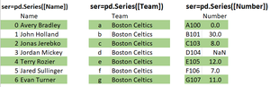
Series
The axis labels are collectively called indexes. Pandas Series is nothing but a column in an excel sheet.
Labels need not be unique but must be a hashable type.
The object supports both integer and label-based indexing and provides a host of methods for performing operations involving the index.
Pandas Series is a one-dimensional labeled array capable of holding data of any type (integer, string, float, python objects, etc.).

Slide 9
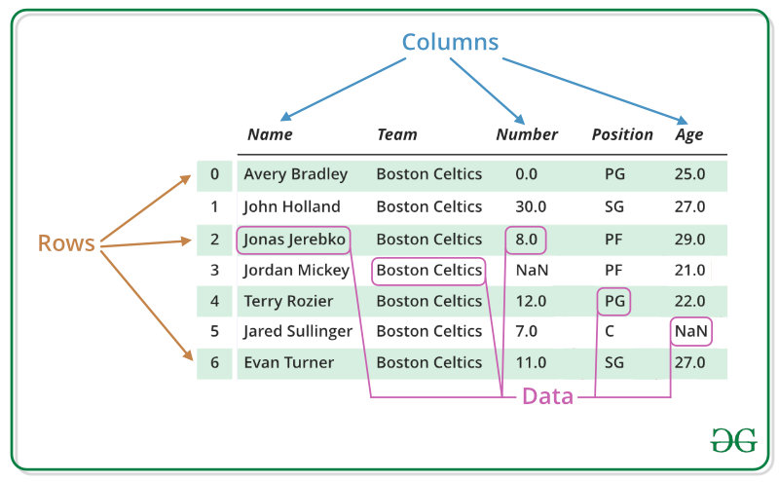
DataFrame
Pandas DataFrame is a two-dimensional size-mutable, potentially heterogeneous tabular data structure with labeled axes (rows and columns).
A Data frame is a two-dimensional data structure, i.e., data is aligned in a tabular fashion in rows and columns.
Pandas DataFrame consists of three principal components, the data, rows, and columns.

Slide 10

Link to Colab
Pandas Documentation
https://pandas.pydata.org/docs/user_guide/index.html
Reference
https://www.geeksforgeeks.org/introduction-to-pandas-in-python
https://www.w3schools.com/python/pandas/default.asp
https://tinyurl.com/pdcb1

Slide 11



